Slide 1
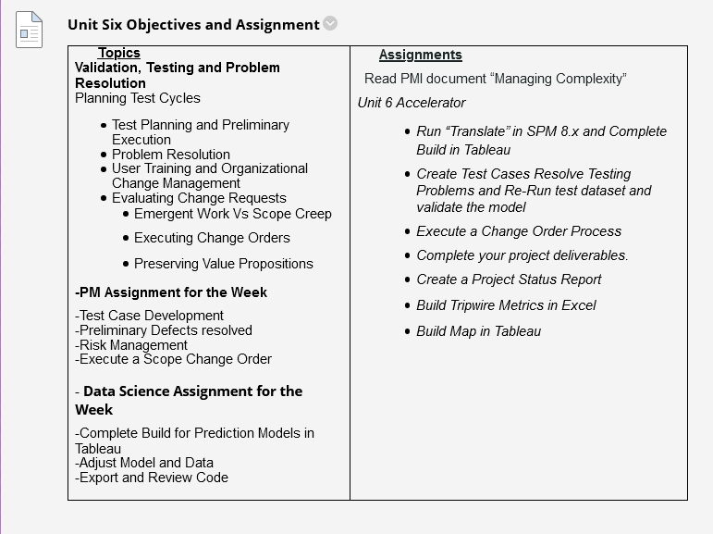

Slide 2
Homework Observations
Overall solid work. Excellent collaboration. Tableau calculations tie out with SPM.
For about 80% of the states, Random Forest did a better job than a linear model. But the Cost-Benefit decision leads us to the linear model for deployment.
We will take the treenet and mapping ideas further and begin to form response plans and to prioritize.
After building our Tripwire metrics Workbook in Excel, we will be ready to close out the modeling phase of CRISP-DM.
We now assume that we have deployed machine learning and graphical tools in a test environment and next we need to create user acceptance test cases and training/testing documentation. Then next week we start the testing process. For the most part change orders have been approved.

Slide 3
Example: Deploying a MARS Model to Tableau
And Answering Accelerator Homework Question #1

Slide 4
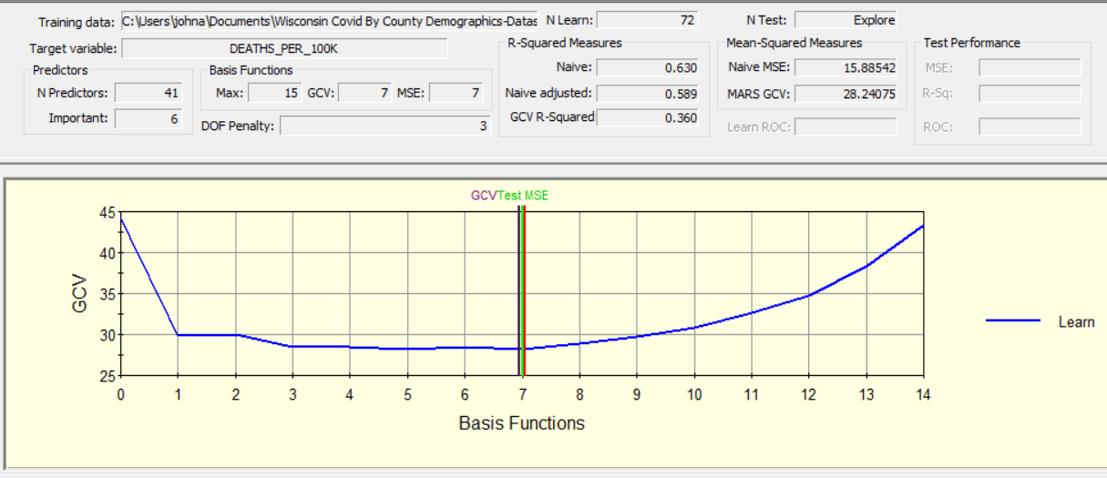
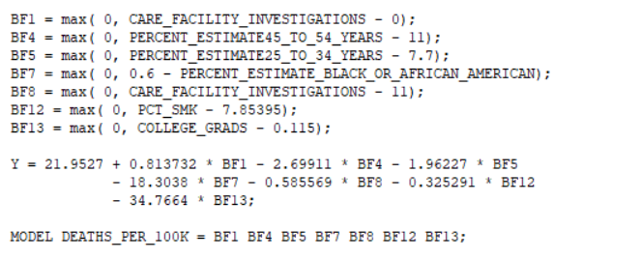
Wisconsin Dataset

Slide 5
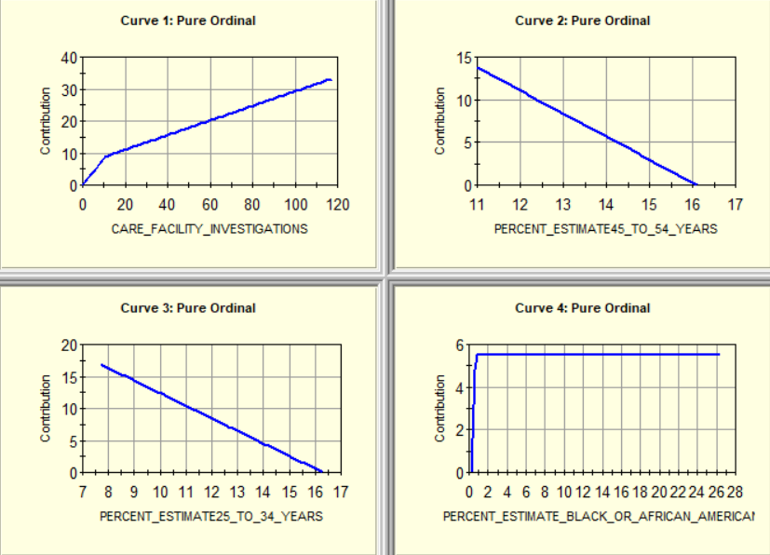
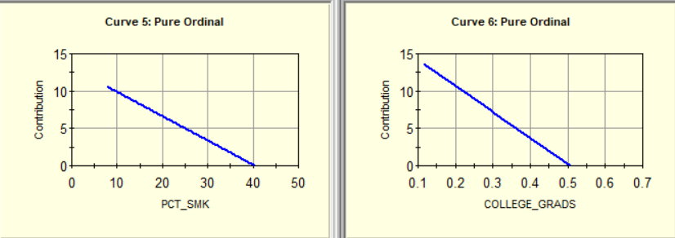

Slide 6
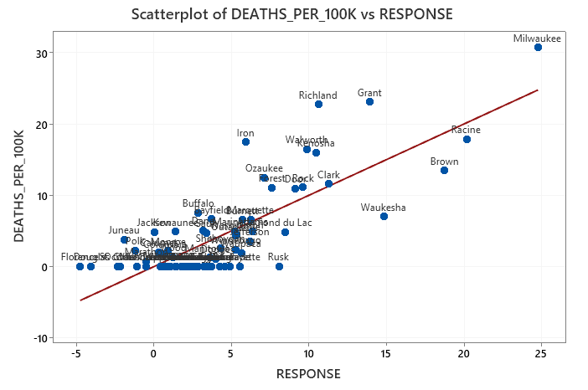
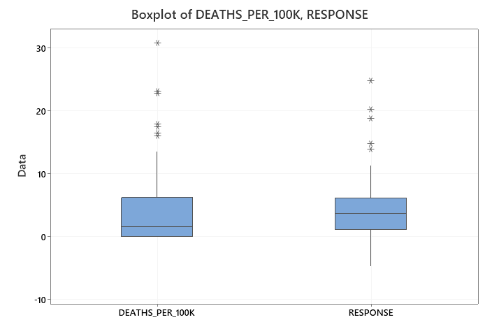
MARS
MARS
Regression predictions commonly under-estimate the most extreme cases. Can have negative values as outliers.
Notice Negative Predictions Possible with Regression

Slide 7
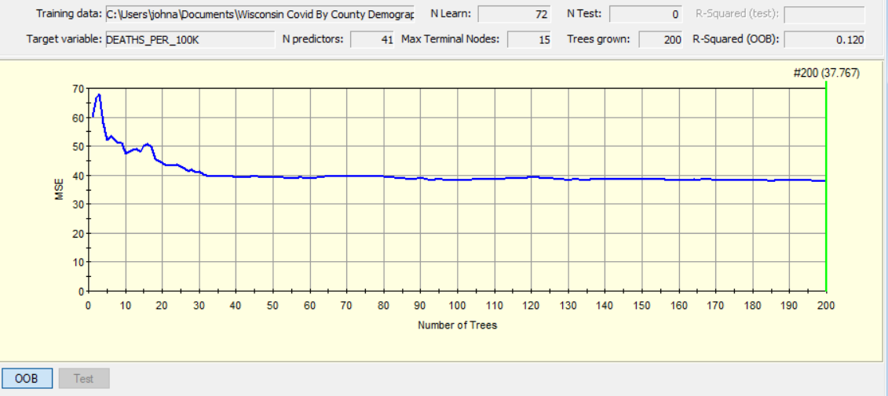
Random Forest

Slide 8
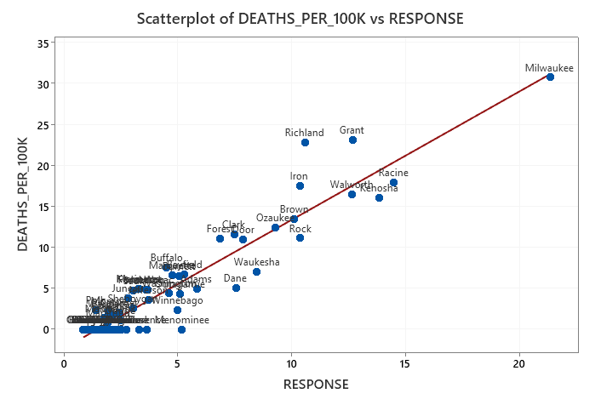
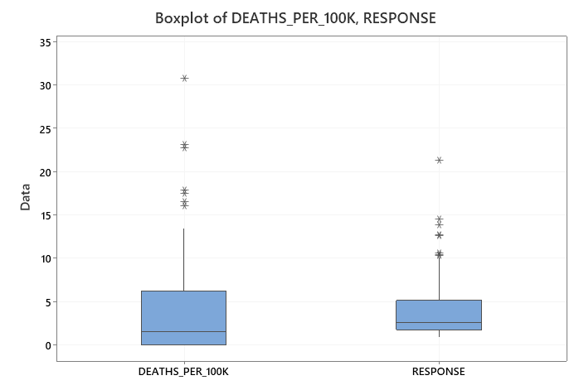
RANDOM FOREST

Slide 9
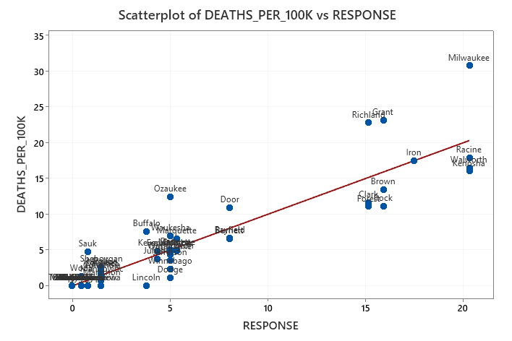
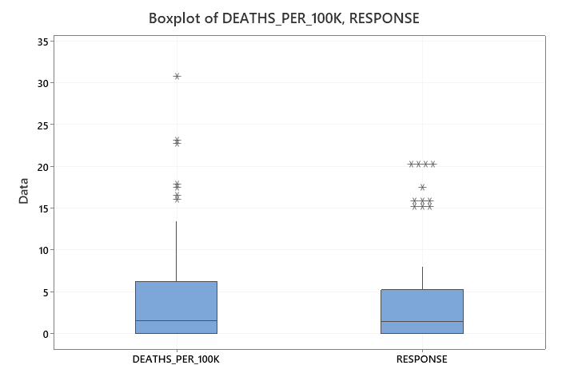
CART

Slide 10
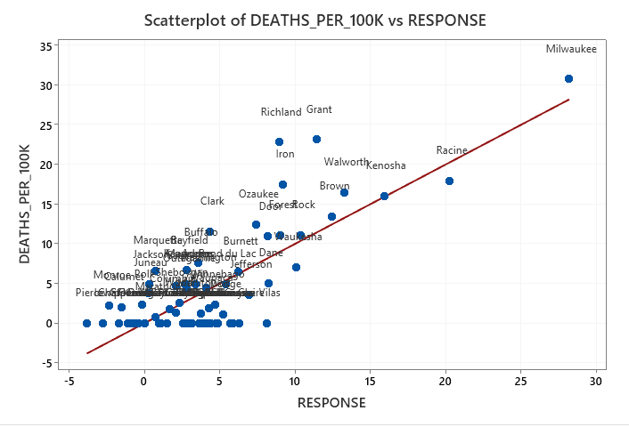
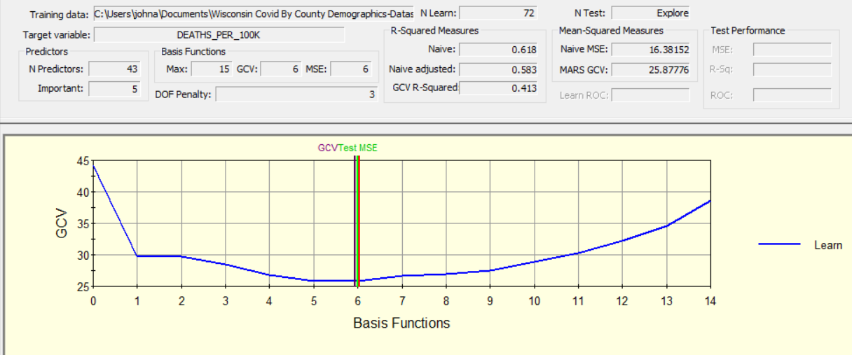
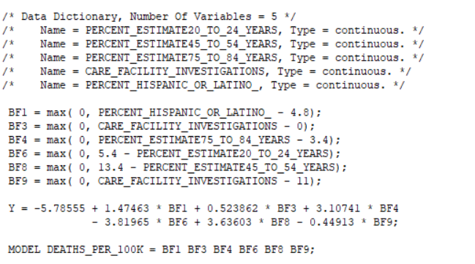
Wisconsin Example Exporting a MARS Model Into Tableau Using Six Basis Functions

Slide 11
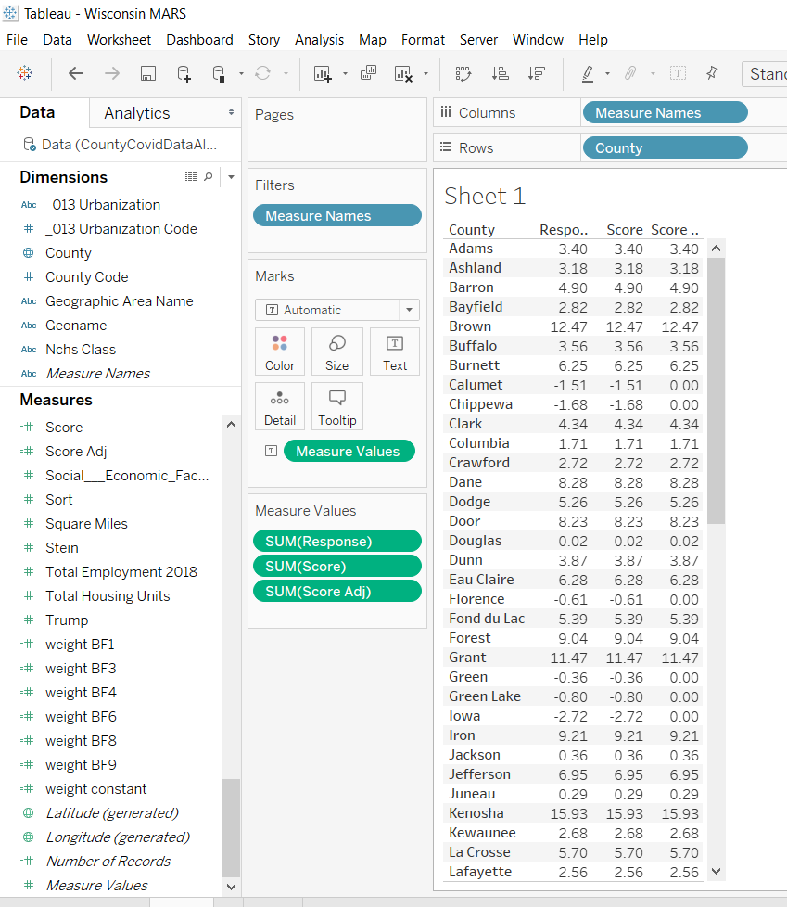
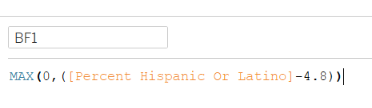
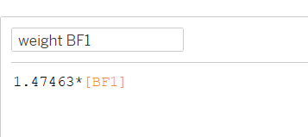
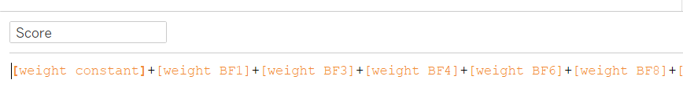
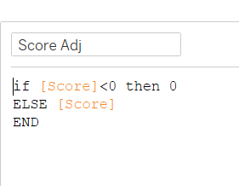

Slide 12
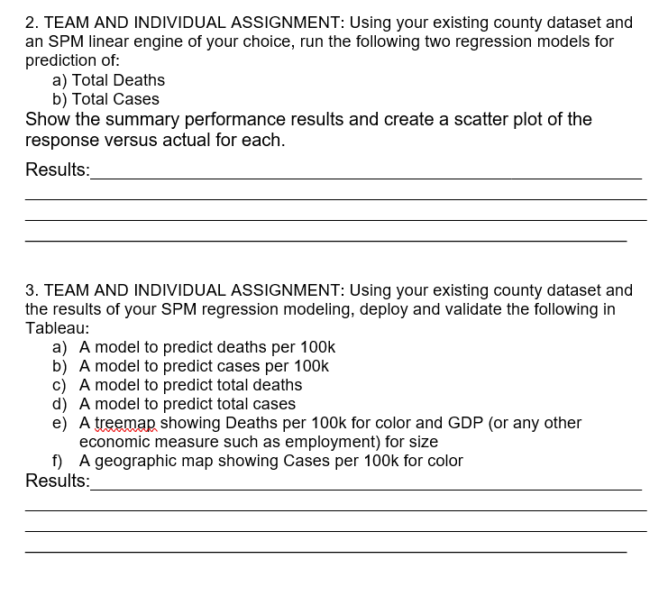
Ready for User Acceptance Testing to start

Slide 13
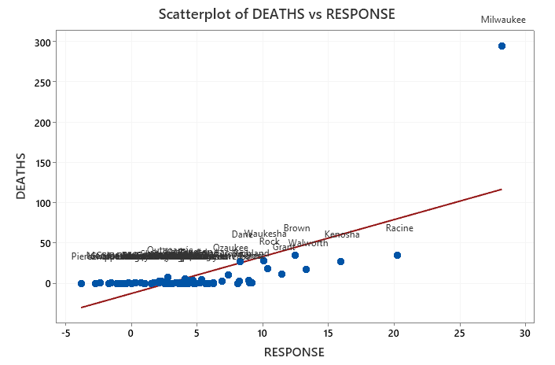
Outlier Effect

Slide 14
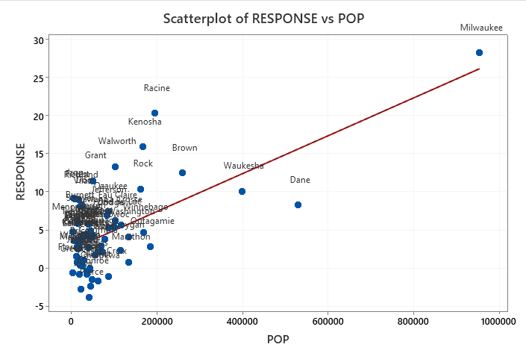
No Material Evidence of Heteroscedasticity for Wisconsin

Slide 15
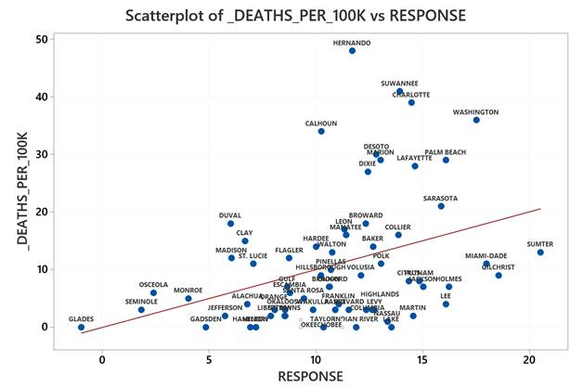
The Florida team, on the other hand, is showing signs of heteroscedasticity
Estimators are unbiased but inefficient. Continue with the model as is. Could be caused by omitted explanatory variable

Slide 16
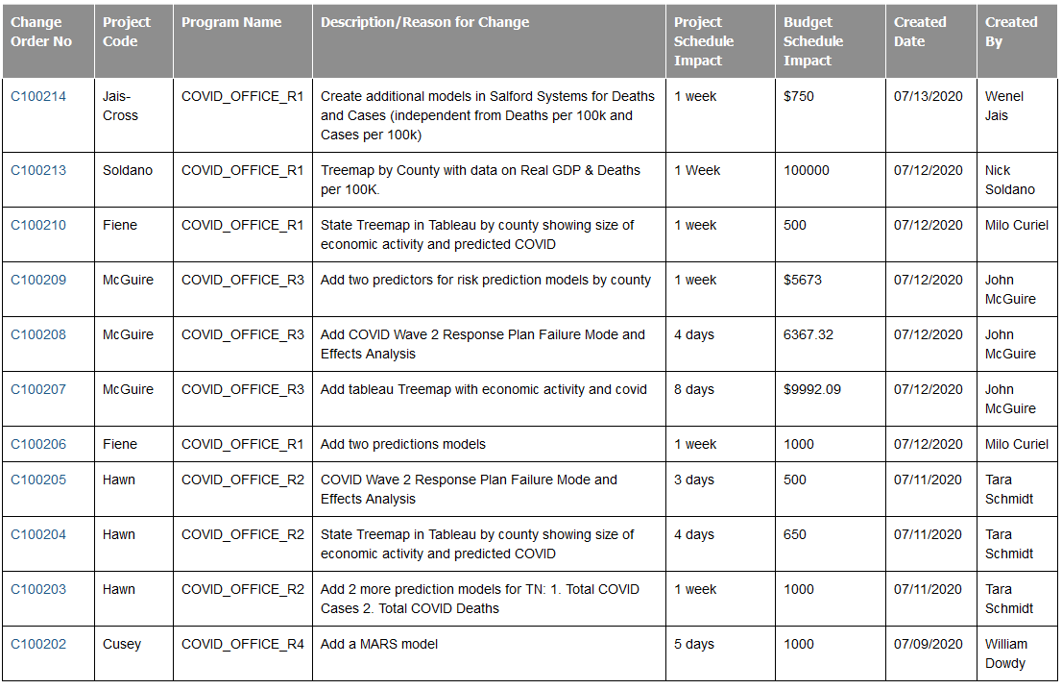
Homework—Change Orders Successfully Submitted and Generally Accepted

Slide 17
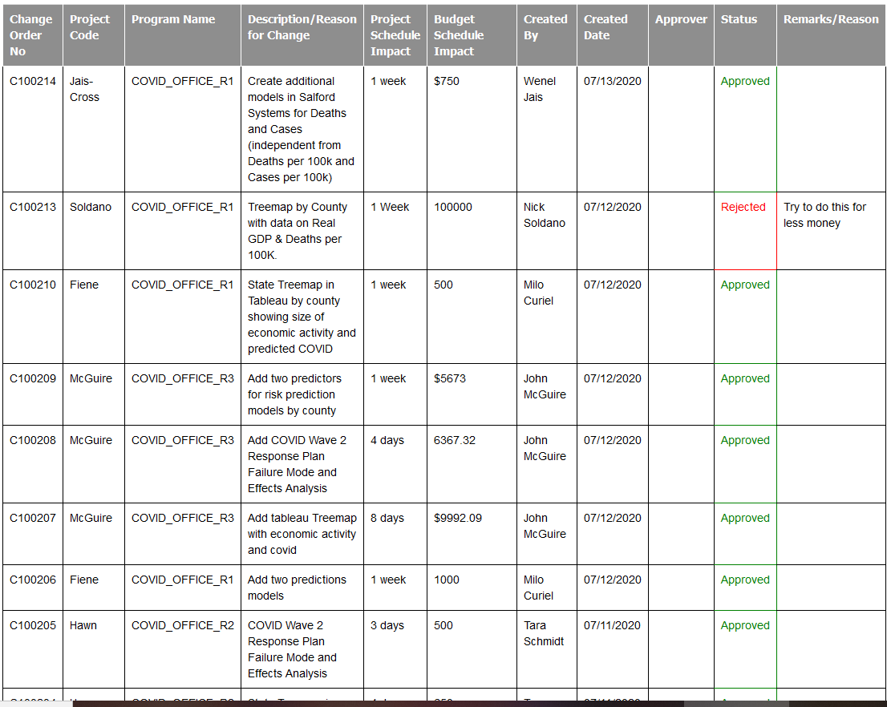

Slide 18
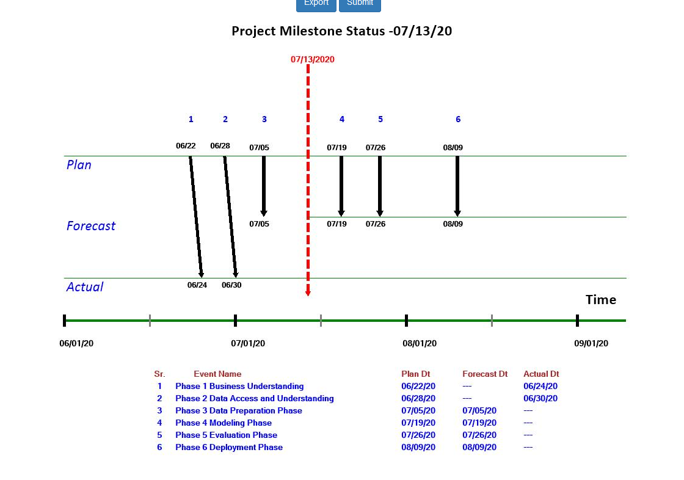
Data Prep Should Be Closed Out Now
Modeling Should be closed out this week once we build out our Tripwire Metrics workbook in Excel.

Slide 19
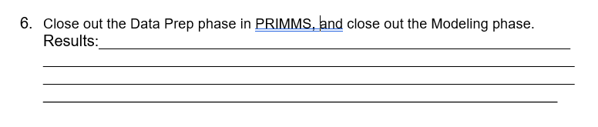

Slide 20
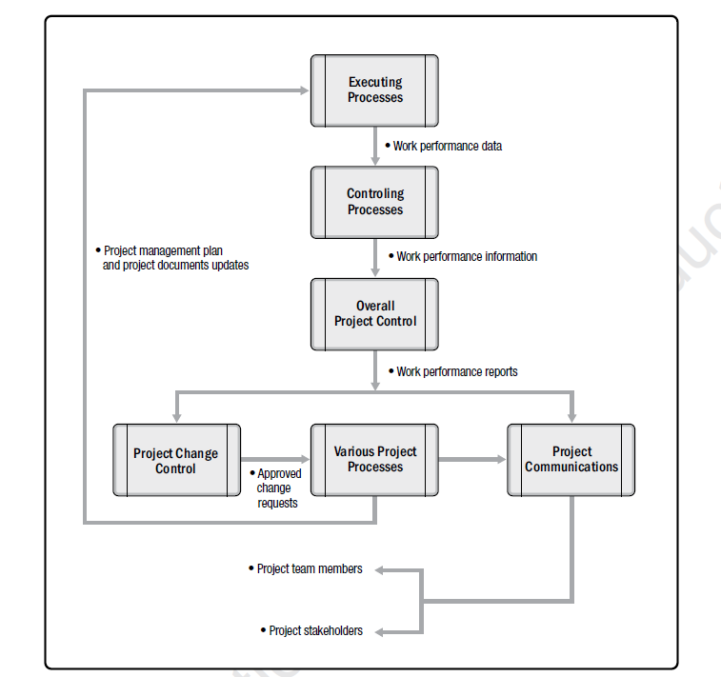
Change Control is the Foundation of Scope Management and the Essence of Contract Management

Slide 21
Scope Management Challenge
$
New Benefit
Sponsor wants more (visible) but additional costs are not visible
∆ Scope
Original Benefit
Cost of Changing/Adding Scope
Value From Changing/Adding Scope
Time
Discussion Example: This Week Your Instructor Discovered That the Ratio of Positive to Negative COVID Test Outcomes is a Powerful Predictor of Deaths Per 100k. At this late stage in the project what would be the benefit vs cost of changing the deployed model?

Slide 22
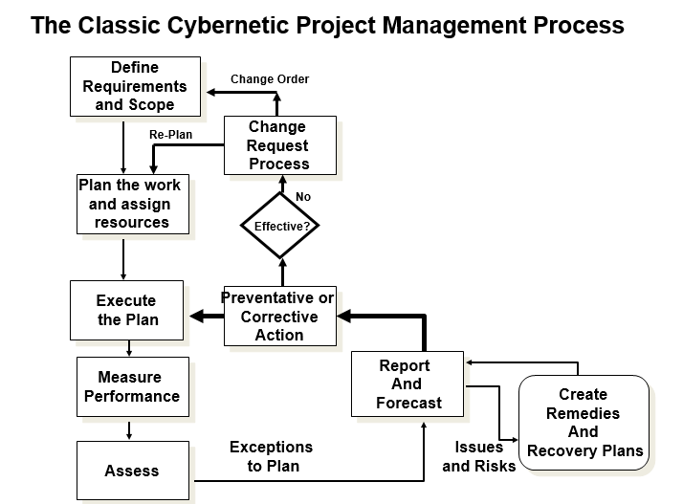

Slide 23
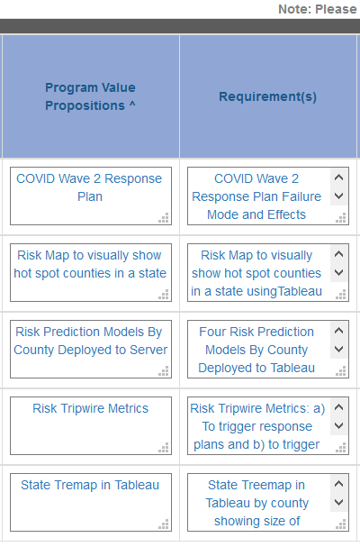
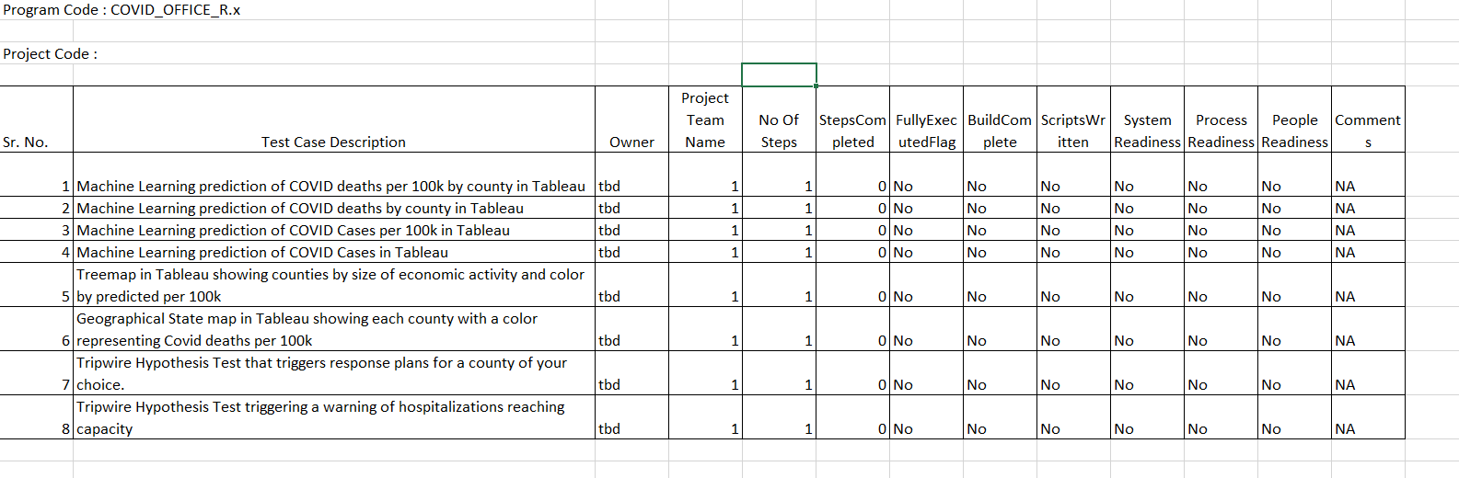
Current View of Scope Targeted For Completion By End of Week 8

Slide 24
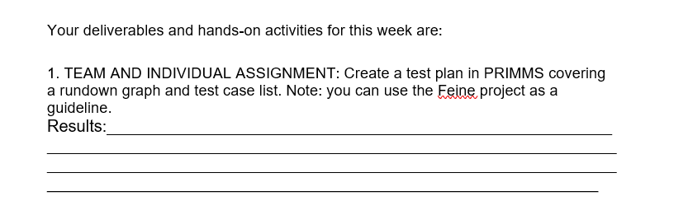

Slide 25
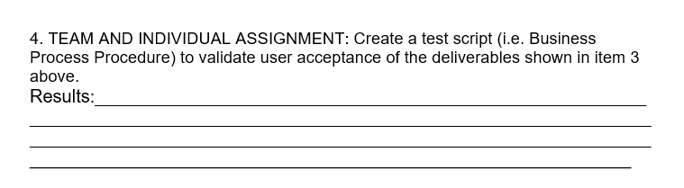

Slide 26
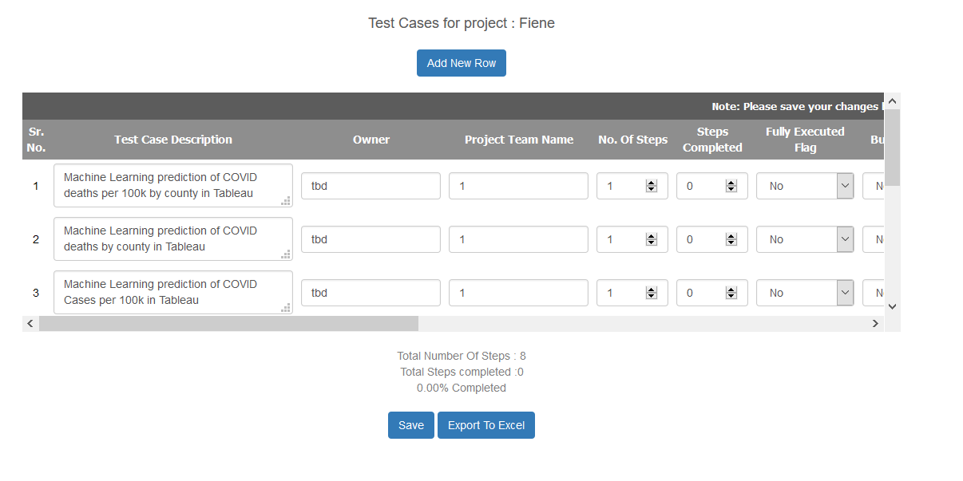

Slide 27
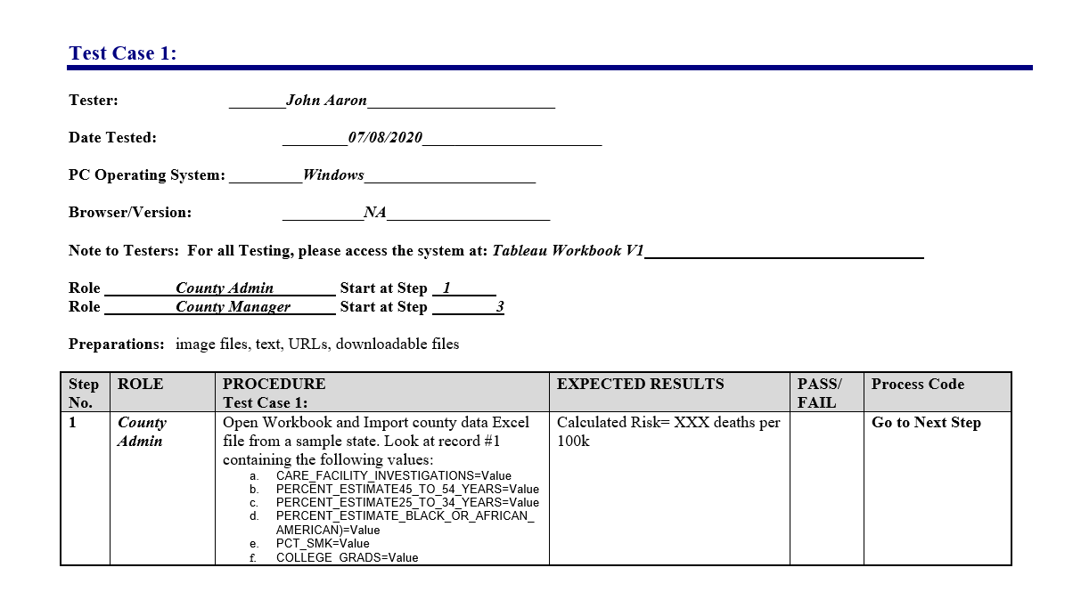

Slide 28
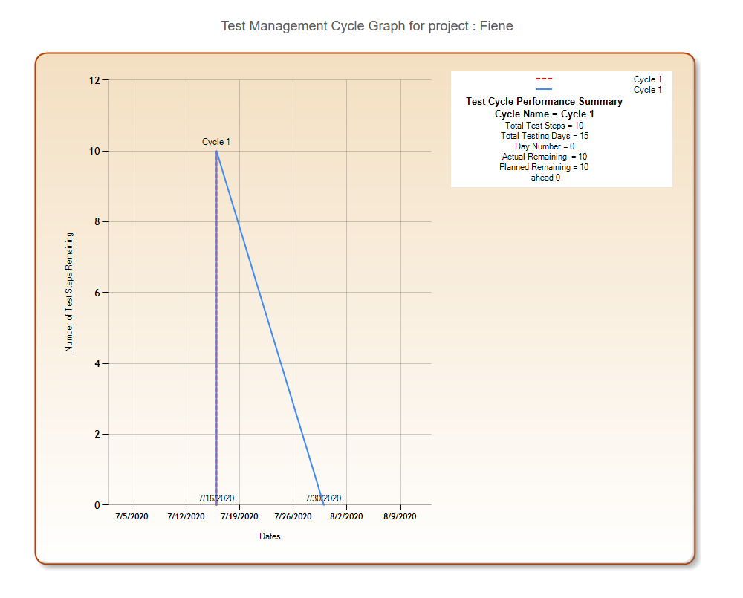

Slide 29
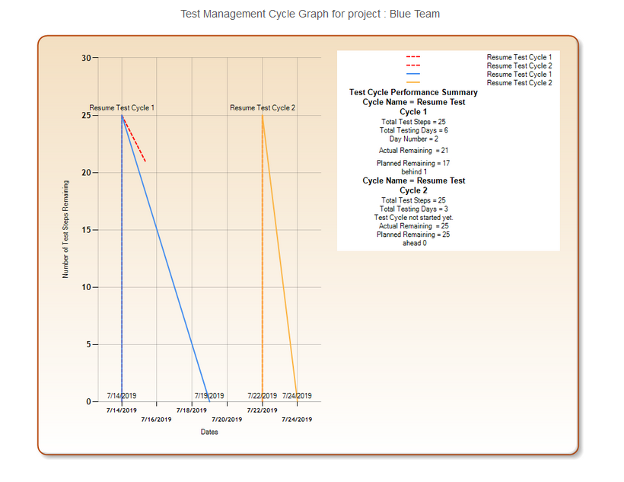

Slide 30
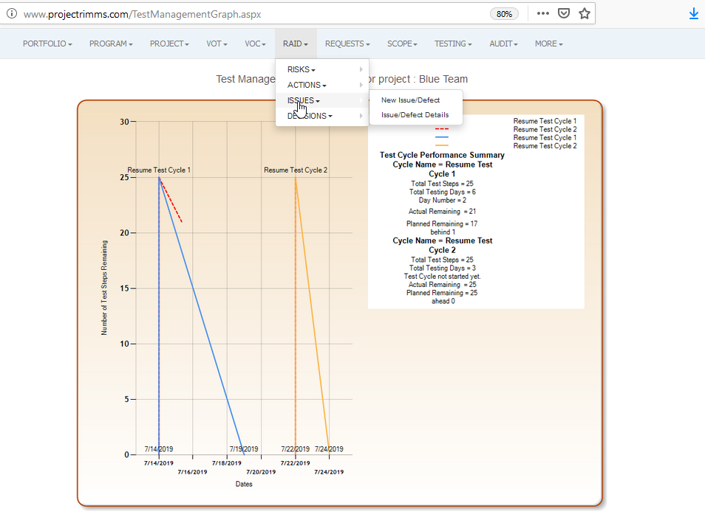

Slide 31
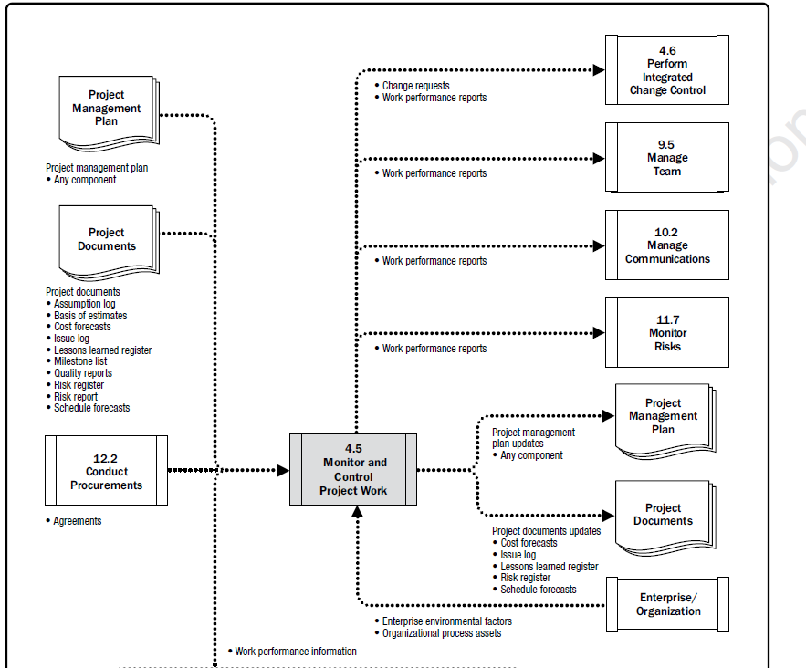
We Have Demonstrated Good Management Practices

Slide 32
Certain Expectations of Quality Exist
Think of the Recent Boeing Disaster. Is it likely that proper testing was performed on that automated system?

Slide 34
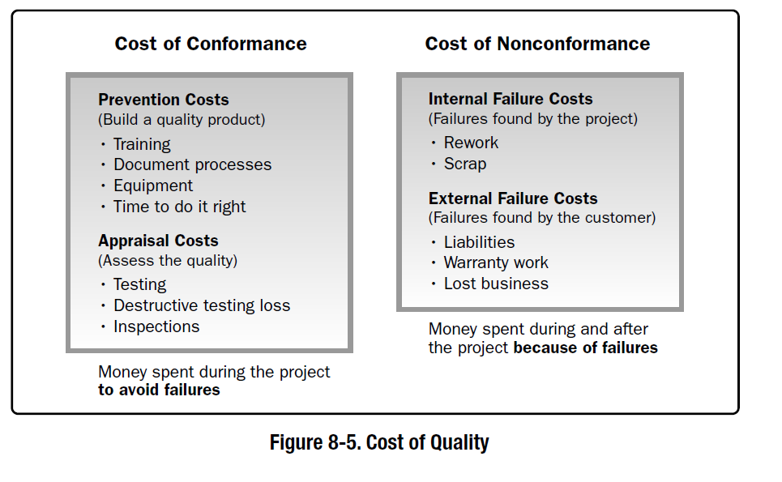
Over the Next Weeks We Will Spend Time on Test Execution, Today We Are Still Focused on Building the Deliverables to Be Tested

Slide 35
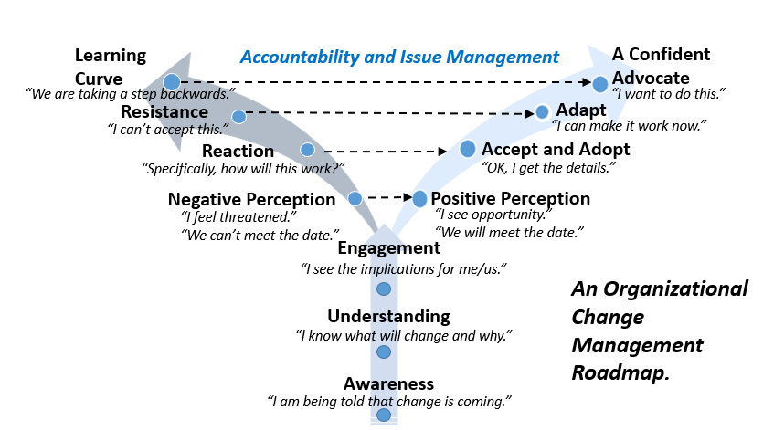
Managing Organizational Change

Slide 36
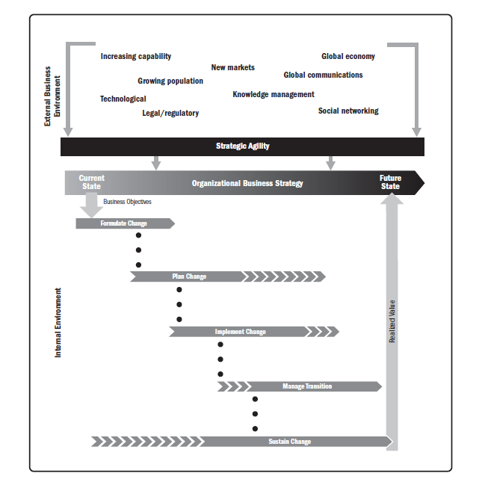
Organizational Change Management
“Change Management is a comprehensive, cyclic and structured approach for transitioning individuals, groups and organizations from a current state to a future state with intended business benefits.”
PMI: Managing Change in Organizations-A Practice Guide

Slide 37
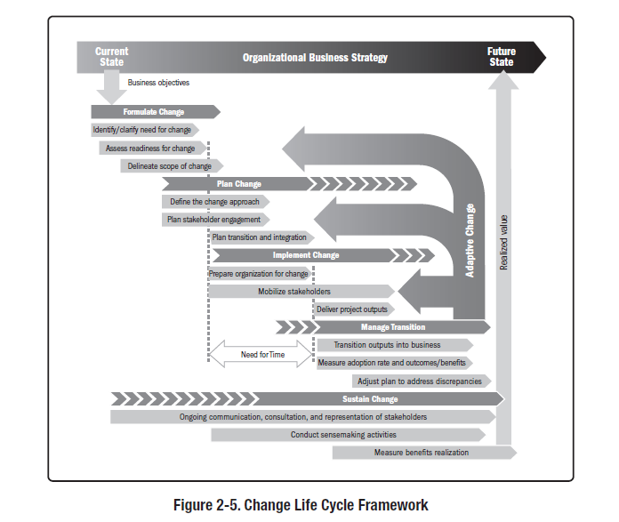

Slide 38
Tripwire Metrics and Hypothesis Testing

Slide 39
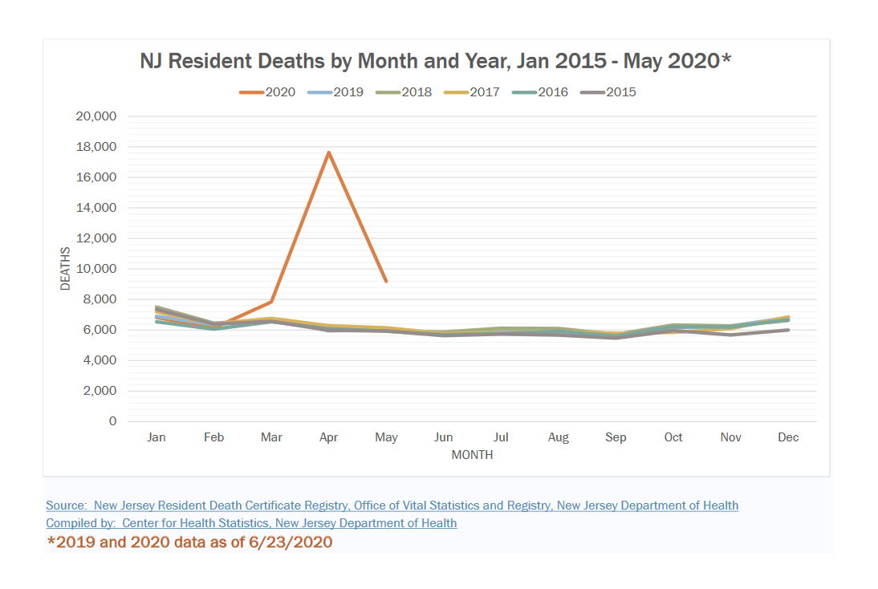
We Have Been Presented With Compelling Evidence As To Why An Emergency Situation Was Declared For Certain Geographical Regions
Example: New Jersey

Slide 40
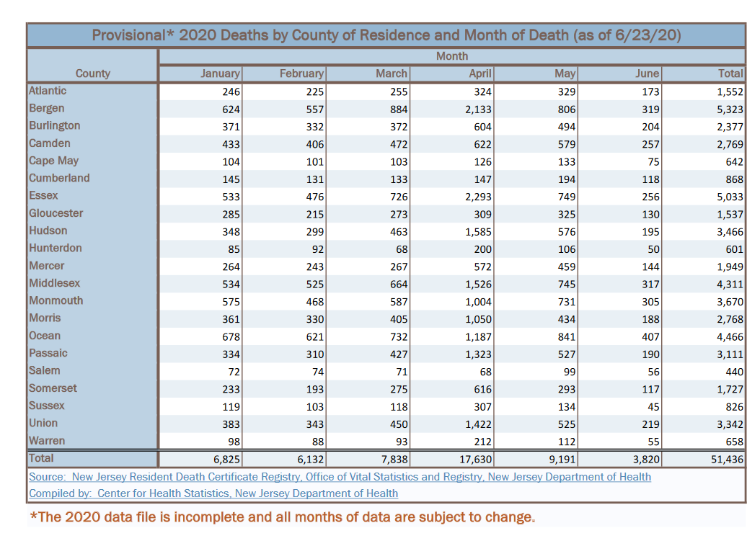
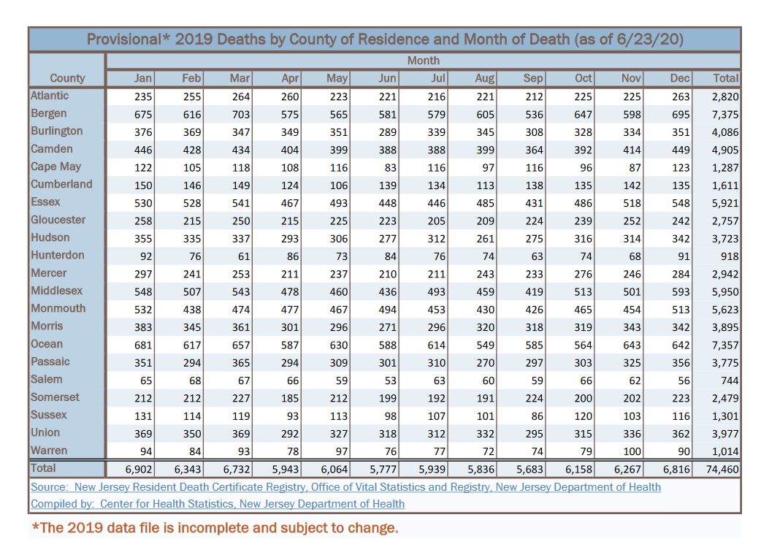
But The Problem Does Not Effect All Geographical Regions Equally
Some States Caught Up In the Principle of Insufficient Reason and Treated All Regions Uniformly—not an optimal policy
https://nj.gov/health/chs/documents/2015-2020%20Deaths%20by%20Month%20and%20County%20of%20Residence.pdf

Slide 41
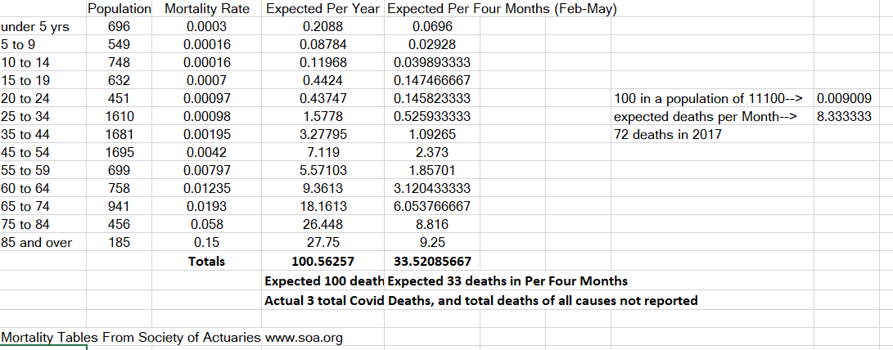
Nantucket Massachusetts Example
Another source shows 1 COVID death
Must also consider availability of only 11 hospital beds

Slide 42
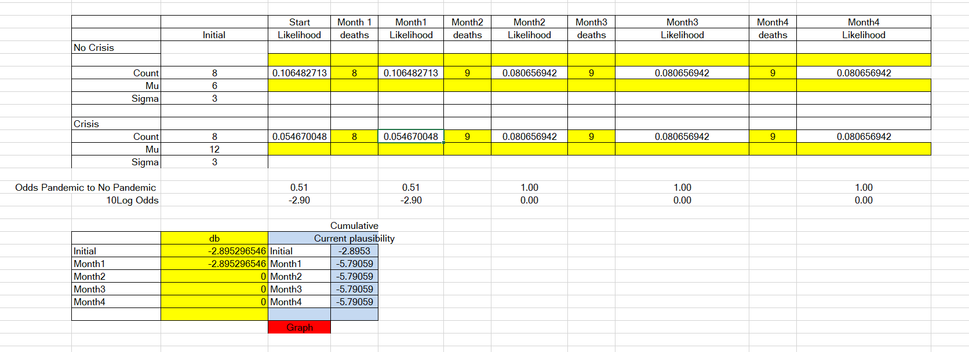
Nantucket County Monthly Mortality Calculator Example Using Standard Normal Density
Your assignment requires you to develop a weekly calculator for your selected county

Slide 43
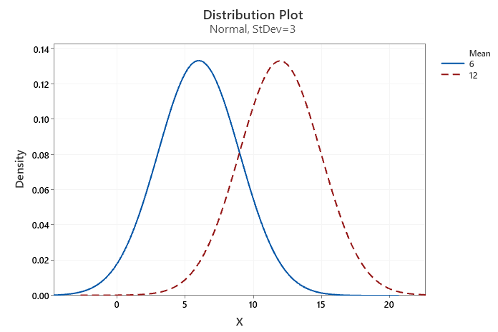
Likelihoods
Month 1 Weight Likelihood Ratio:
0.0546/0.1064=0.51
10Log₁₀ Odds= -2.90
_{db= -2.90}
No Crisis Hypothesis
P(E|H₀)
Crisis Hypothesis
P(E|H₁)

Slide 44


Slide 45


Plausibility in db

Slide 46

The Workbook Provided Gives Standard Normal Density
You Should Modify Mean and Standard Deviation To Suit Your County For Weekly Sequential Data

Slide 47


Slide 48


Slide 49


Slide 50


Slide 51


Slide 52

Fast Forward to the Year 2007
Reinforces the soundness of using a Bayesian Tripwire Metric

Slide 53


Slide 54

The author re-wrote I.J. Good’s 1950 Dice example.

Slide 55



Bayesian Belief Network to Aid Decision Making—Dane County WI Example
Death Rate Drivers Controllable?
Short Term

Slide 56
Death Rate Drivers For Wisconsin Are Tied to Variable Importance

Slide 57

Deaths per 100k

Slide 58

The Longer-Term Policy Strategy Will Be Tied To Leveraging Opportunities for Migration of Labor and Capital
Large Central Metros
Profit
Other More Rural
Profit
Labor, Capital
Labor, Capital
Migration of Labor and Capital
Gary Becker’s “Economic Approach to Human Behavior”

Slide 59

Short Term Drivers Based Upon Variable Importance
Firearm Homicides highly correlated with COVID deaths per 100k mainly due to Milwaukee

Slide 60

Key Death Rate Drivers for the State

Slide 61


Slide 62




Slide 63


Slide 64









Probability is “Partial Belief” and Measured as “Degrees of Belief”
And the Controversy in the 1920s Through the 1950s
Harold Jeffreys
Bruno De Finetti
Frank Ramsey
Probabilities can be compared ordinally
Jimmie Savage
Ronald Fischer
(no such thing as subjective probability)
Alan Turing
E.T. Jaynes
Good and Turing successfully used probability measures at Bletchley Park to break Enigma and Tunny

Slide 65



Bayesians Define Probability as “Partial Belief” and Measured by “Degrees of Belief”
Frequentists
Bayesians
Frank Ramsey
John Maynard Keynes
Can’t Measure Probabilities
P={Observed freq./Total Opportunities}
Tied to Betting Odds: the process is subjective
I.J. Good

Slide 66
Ramsey/de Finetti---Subjective Nature of Probability
Ramsey and de Finetti showed independently that subjective probability is not just any set of beliefs, but beliefs that conform to the axioms of probability
The Ramsey-de Finetti theorem states that if p₁,p₂… are any set of betting quotients on hypotheses h₁,h₂…then if the p_{j} do not satisfy the probability axioms there exists a betting strategy and set of stakes such that whoever follows this betting strategy will lose a finite sum whatever the truth values of the hypotheses turn out to be.
Bayes’ theorem tells us how we should rationally update subjective, probabilistic beliefs in light of evidence.

Slide 67

Bayes’ Theorem and the Axioms of Probability
-Likelihood is analysis of current evidence and focus class
-Prior is tied to Experience (if we wish to include it)
-Posterior is the resultant probability
Posterior= Prior*Likelihood
To be a Bayesian, one considers the evidence at hand and prior information
Ramsey’s winning argument was that if you do not consider probabilities in this manner, you can be “dutch booked”.
We consider this in regard to decision making within competitive environments.

Slide 68


